Slide 1

Task Management Application

Slide 2
Members
2200031862 – Manchineni Navya Sai Kalamani
2200032883 – Challa Haasitha Reddy
2200032922 – Bandaru Sriya Avyakta

Slide 3

Introduction
Our Task Management Application uses JavaScript technologies to automate and streamline task tracking. With this web-based system, tasks and projects can be completed efficiently, enhancing productivity and improving collaboration. Centralized task creation, deadline setting, responsibility assignment, and progress monitoring are easy.

Slide 4
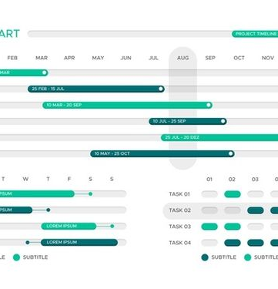
Customer Journey map
The development of the task management application requires the following roles and stakeholders:
- UX Designers: create an intuitive and seamless experience for students.
- Developers: build and implement the app's technical aspects.
- Marketing Team: develop effective strategies to promote the app to students.
- Customer Support: provide prompt assistance to users encountering issues.
- Educational Institutions: seek partnerships or integrations with educational platforms to enhance the app's utility.
- Students: their preferences and needs drive the app's design and functionality.

Slide 5
Modules & Sub-modules
1. User Management:
User Authentication
User Profiles
2. Task Creation and Management:
Task Creation
Task Editing
Task Organization
Task Completion
3. Project Management:
Project Creation
Project Collaboration
4. Reminders and Notifications:
Task Reminders
Notifications

Slide 6

5. Calendar Integration:
Sync with Calendar
6. Dashboard and Analytics:
User Dashboard
Analytics
7. Collaboration and Communication:
Comments and Discussions
File Attachments
8. Settings and Preferences:
User Preferences
Notification Settings
10. Integration with External Tools:
Third-Party Integrations
11.Reporting:
Task and Project Reports
12.Gamification:
Achievements and Rewards
13.Accessibility:
Accessibility Features

Slide 7
Main features
User Dashboard:
Overview of tasks, projects, and upcoming deadlines.
Task completion statistics and progress tracking.
Integration with External Tools:
Connect with popular productivity tools (e.g., Google Drive, Dropbox).
APIs for potential third-party integrations.
Settings and Preferences:
User preferences for themes and language.
Notification customization options.
Feedback Mechanism:
User feedback forms for continuous improvement.
Ratings and reviews for tasks and projects.
Offline Mode :
Capability to work on tasks without an internet connection.

Slide 8
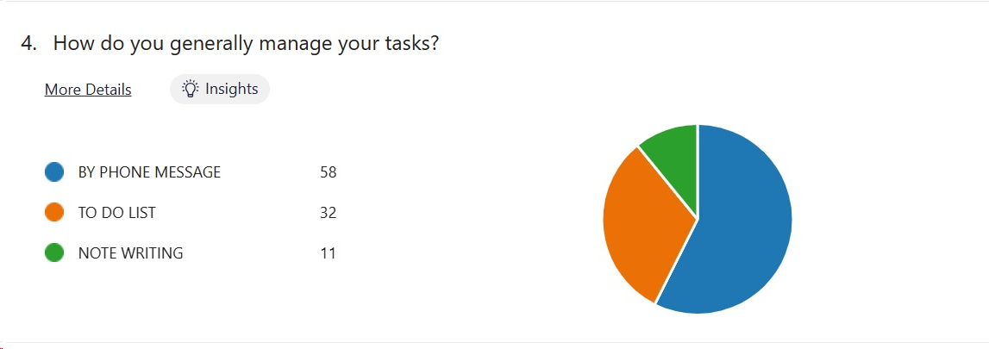
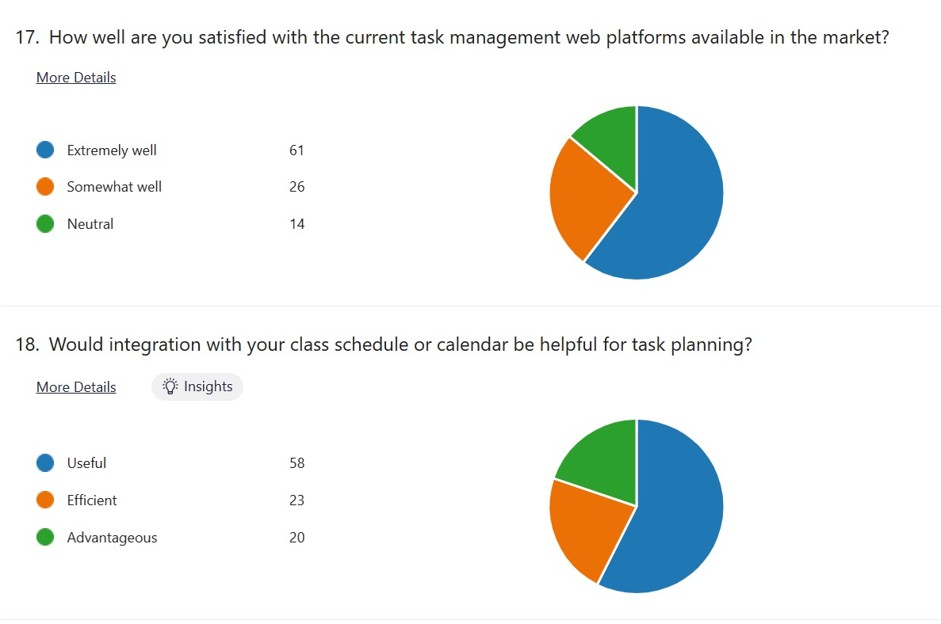
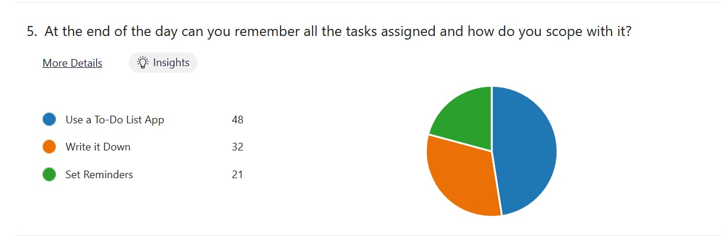
Survey

Slide 9
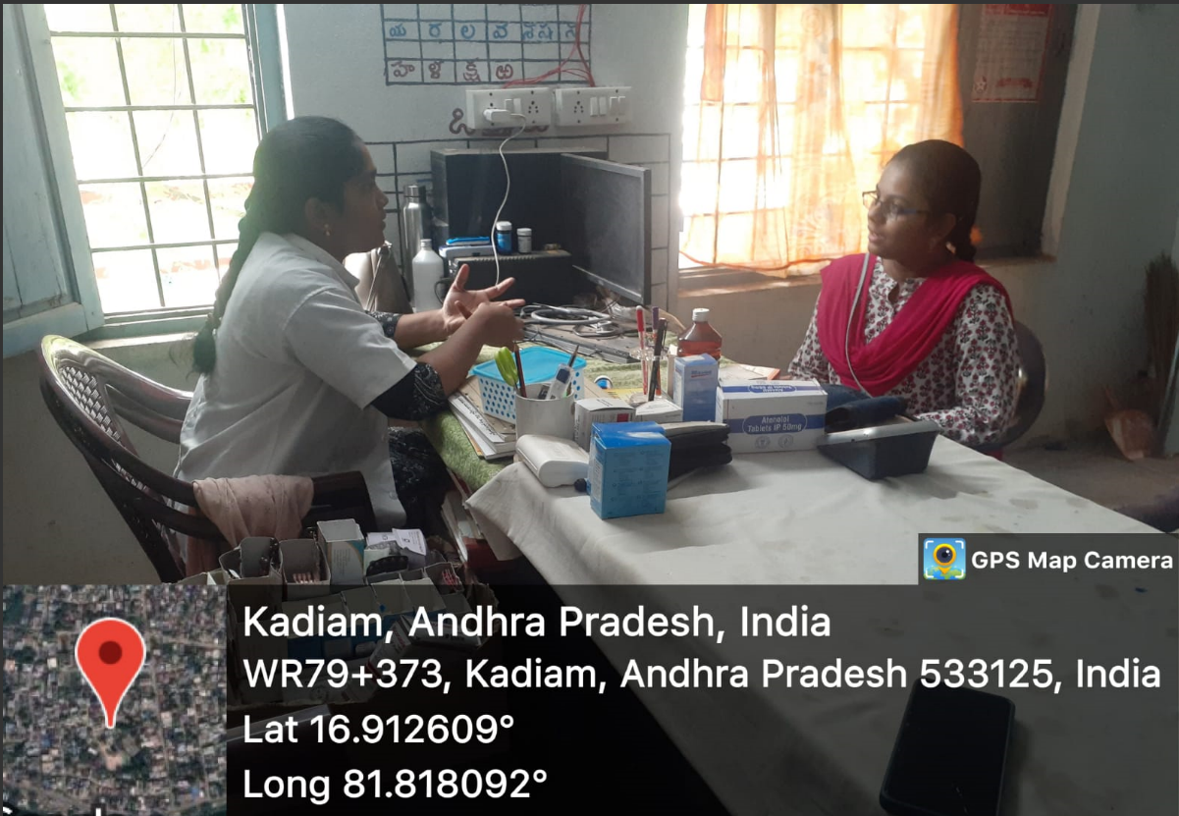
Field Survey
We Conducted a field Survey
where our team and
interviewed a
doctor enquiring about her way
of managing her tasks to cope
up with her busy schedule.

Slide 10
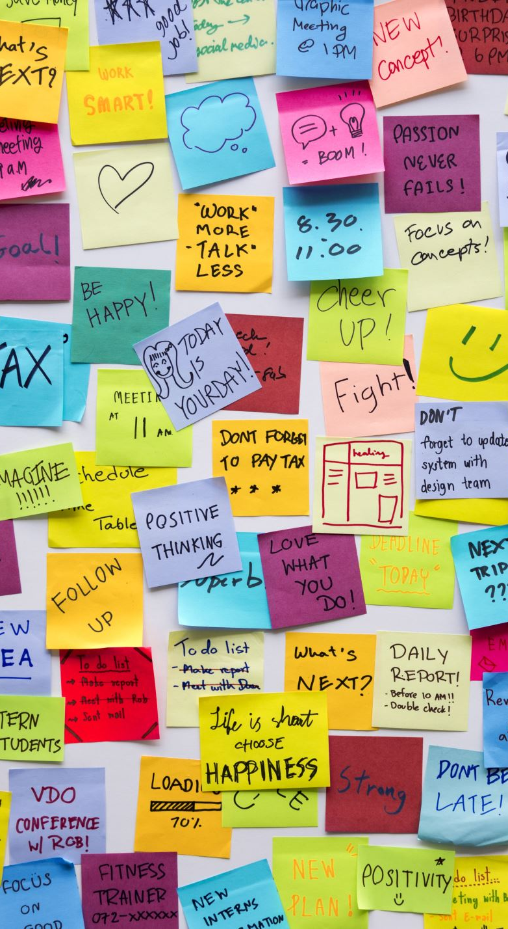
Primary goals
Our platform offers efficient task management features to easily
- Categorize tasks with ease
- Tag tasks for better organization
- Set priorities to focus on important tasks
- Assign due dates to stay on track
- Collaborate with team members for better productivity- Receive reminders to stay on top of tasks
- Track task completion for better progress monitoring
- Secure login, authentication, and encryption options for data protection
- Filtering options to streamline task management and achieve your goals efficiently.

Slide 11

Features
Task Management Apps offer:
- Easy task creation, editing, and deletion
- Prioritization, due dates, and deadlines
- Task organization into categories or folders
- Collaboration tools for team members
- Progress tracking and reminders for upcoming deadlines
- Cross-platform accessibility for working from anywhere
- Search and filter options for efficient task management
- Secure login and data encryption to protect task-related information
Task Management Apps are the perfect solution for managing your tasks and increasing your productivity.

Slide 12
Additional things
- Gamification: Use playful elements to motivate task completion.
- Analytics and Reporting: Gain insights for improvement through productivity and team performance data.
- AI-Powered Task Recommendations: advantage AI for task priorities and efficiency.
- Virtual Assistants or Chatbots: Improve user experience with real-time assistance.
- AR Task Visualization: Use AR for task management in spatial projects.
- Emotional Well-Being Tracking: Monitor stress for work-life balance and employee well-being.

Slide 13
Conclusion
In today's fast-paced world, task management apps simplify work and boost productivity. They offer a range of features, such as task creation, prioritization, progress tracking, and cross-platform accessibility. With the integration of gamification and AI-powered recommendations, these apps are becoming even more sophisticated and essential for managing modern tasks and projects.

Slide 14


